Slide 1
HMT 801 Travel Agency and Tour Operations
UNIT 4
Travel Entrepreneurship and Sustainable Marketing
Topic
Destination branding and approaches
Course Outcome (CO)
CO5: Evaluate the Sustainability of Travel operations and activities of travel bodies and associations

Slide 2
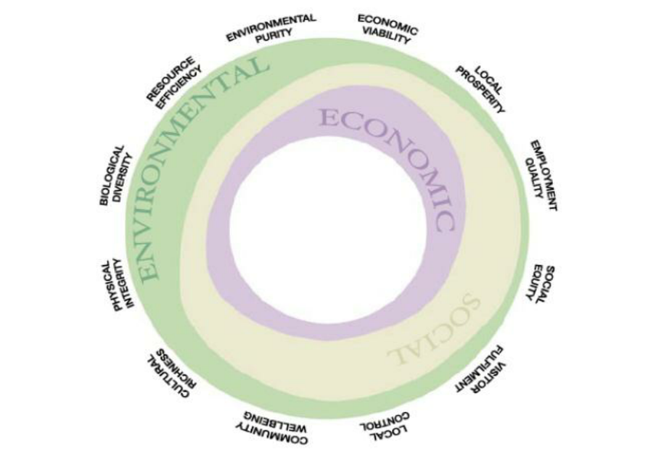

Slide 3
